Slide 1
Radix sort

Slide 2
Radix Sort
Idea
Treats each data to be sorted as a character string.
It is not using comparison, i.e. no comparison between the data is needed.
In each iteration:
Organize the data into groups according to the next character in each data.
The groups are then “concatenated” for next iteration.

Slide 3
Radix Sort
Example
0123, 2154, 0222, 0004, 0283, 1560, 1061, 2150
Original integers

Slide 4
Radix Sort
Example
(1560, 2150) (1061) (0222) (0123, 0283) (2154, 0004)
Grouped by forth digit

Slide 5
Radix Sort
Example
1560, 2150, 1061, 0222, 0123, 0283, 2154, 0004
Combined

Slide 6
Radix Sort
Example
(0004) (0222, 0123) (2150, 2154) (1560, 1061) (0283)
Grouped by third digit

Slide 7
Radix Sort
Example
0004, 0222, 0123, 2150, 2154, 1560, 1061, 0283
Combined

Slide 8
Radix Sort
Example
(0004, 1061) (0123, 2150, 2154) (0222, 0283) (1560)
Grouped by second digit

Slide 9
Radix Sort
Example
0004, 1061, 0123, 2150, 2154, 0222, 0283, 1560
Combined

Slide 10
Radix Sort
Example
(0004, 0123, 0222, 0283) (1061, 1560) (2150, 2154)
Grouped by first digit

Slide 11
Radix Sort
Example
0004, 0123, 0222, 0283, 1061, 1560, 2150, 2154
Combined, sequence are sorted

Slide 12
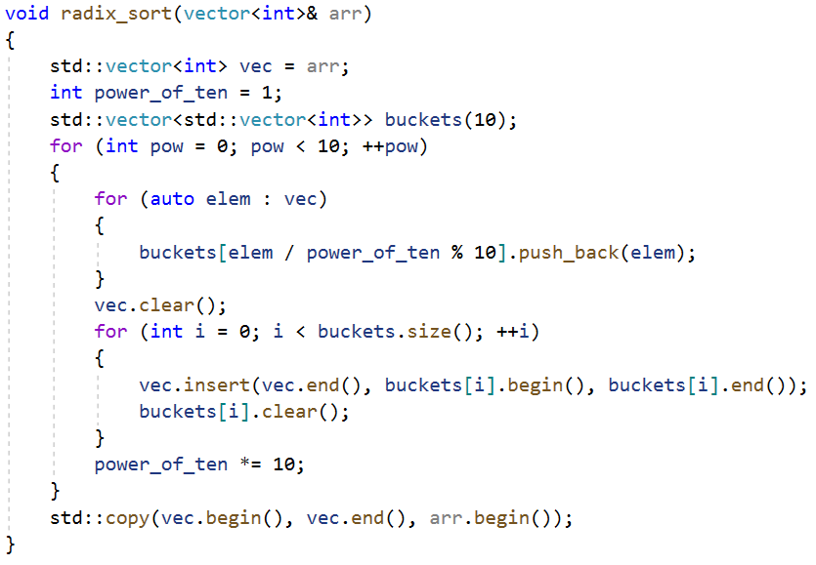
Radix Sort
Implementation

Slide 13
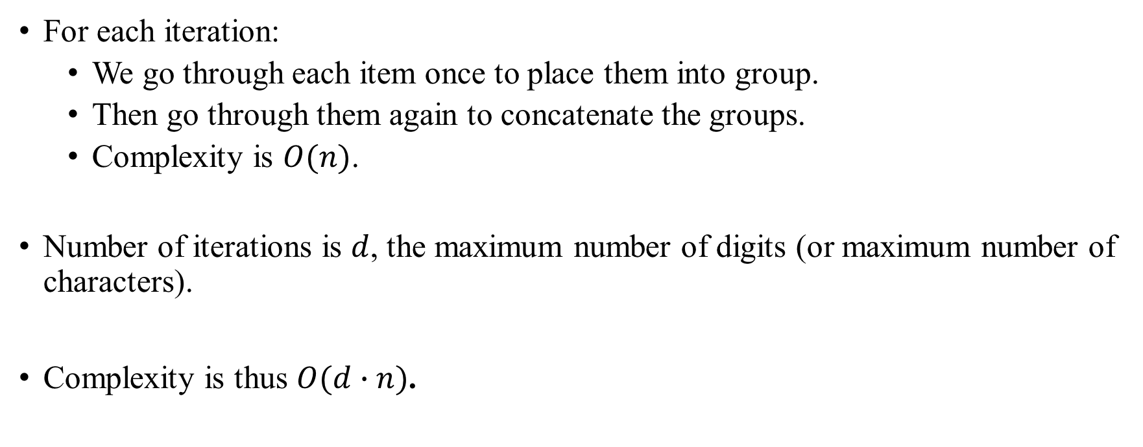
Radix Sort
Analysis

